Slide 1


ADA UNIVERSITY
SYSTEM ANALYSIS & DESIGN
Online Taxi Sharing System
TEAM 01
ANAR BAYRAMOV NARGIZ BAYRAMOVA NIGAR SALAYEVA SANAN MARDANLI

Slide 2

What is Online Taxi Sharing System?
ADA UNIVERSITY
SYSTEM ANALYSIS & DESIGN
Online platform (mobile application or web-based) connecting riders with multiple passengers traveling same direction/sharing same routes
Cost-effective, and eco-friendly alternative to traditional taxis
Creating/joining ride requests, tracking ride, splitting fare among other passengers, rating and reporting driver/service after ride is completed

Slide 3









The specific functionalities that the system should have:
ADA UNIVERSITY
SYSTEM ANALYSIS & DESIGN
Permit sharing their location in order to find the nearest driver or passenger
Enter the destination where want to go
Add ride details automatically to the system when the drivers select destination which should be easily found by passengers
Both card and cash payments should be valid in the system

Slide 4
ADA UNIVERSITY
SYSTEM ANALYSIS & DESIGN
Architectural Design
Client - Server architecture
Scalable and efficient way to handle multiple client requests
Clients communicate with a central server managing core functionalities

Slide 5
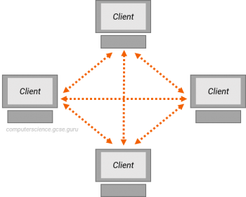
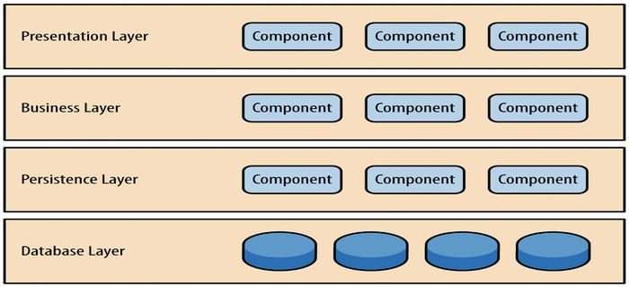
ADA UNIVERSITY
SYSTEM ANALYSIS & DESIGN
Architectural Design
Alternatives Considered
Peer-to-peer
Layered architecture

Slide 6

Strengths of Client-Server
ADA UNIVERSITY
SYSTEM ANALYSIS & DESIGN
Scalability
Centralized management
Simplicity

Slide 7

Deficiencies of Client-Server
ADA UNIVERSITY
SYSTEM ANALYSIS & DESIGN
Single point of failure
Network dependency

Slide 8
Components and functions
ADA UNIVERSITY
SYSTEM ANALYSIS & DESIGN
Client Application
State: user's session state Behavior: UI for passengers
Server
State: system's central state Behavior: communication with client
Driver Application
State: Driver's session state Behavior: UI for drivers
Database
State: stores persistent data Behavior: data retrieval functionality
Geolocation
State: Contain info related to locations Behavior: Geolocation service for the system
Authentication & Authorization
State: maintain user credentials Behavior: verify the identity of users
Notification Service
State: stores delivery status Behavior: handle real-time notifications
Ride Matching
State: maintain rules for matching users
Behavior: analysis of passenger requests
Payment Processing
State: maintain payment information Behavior: handle payments between users

Slide 9






Hardware and Software Specification
ADA UNIVERSITY
SYSTEM ANALYSIS & DESIGN
Database Management Software
Security Software
Networking Equipment
GPS Devices
Analytics Software
Mobile Devices
Payment Processing Equipment
Payment Processing Software
Real-time Location Tracking Software

Slide 10
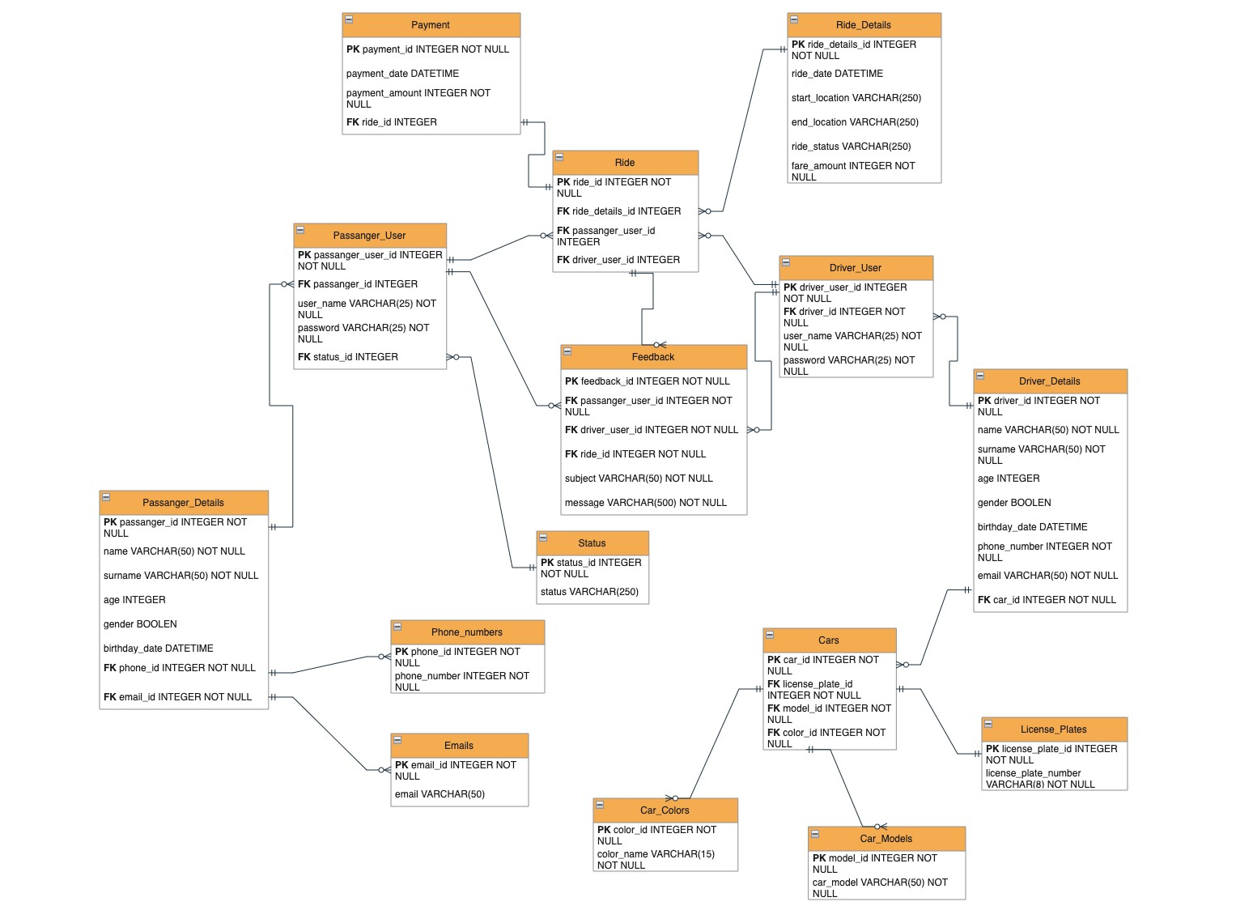
Data Storage Design
ADA UNIVERSITY
SYSTEM ANALYSIS & DESIGN

Slide 11
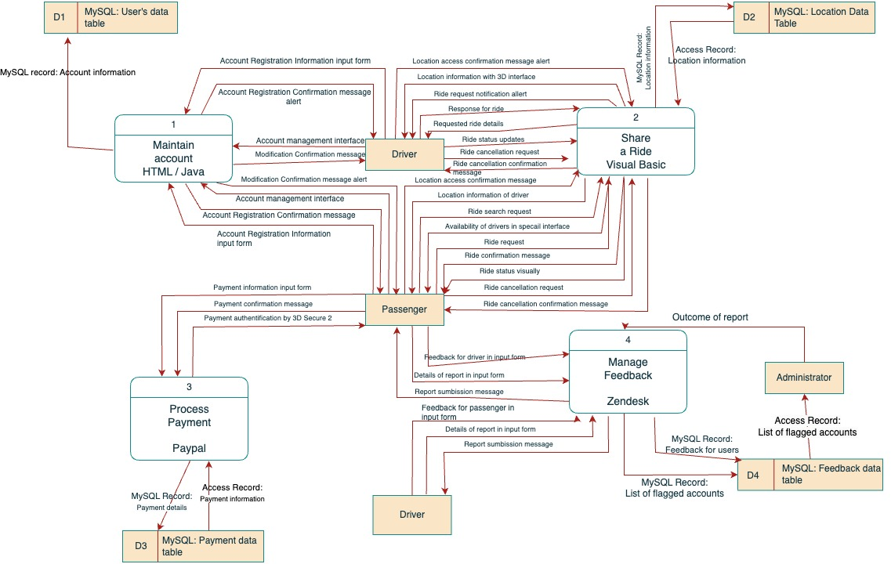
Program Design – Physical DFD
ADA UNIVERSITY
SYSTEM ANALYSIS & DESIGN

Slide 12
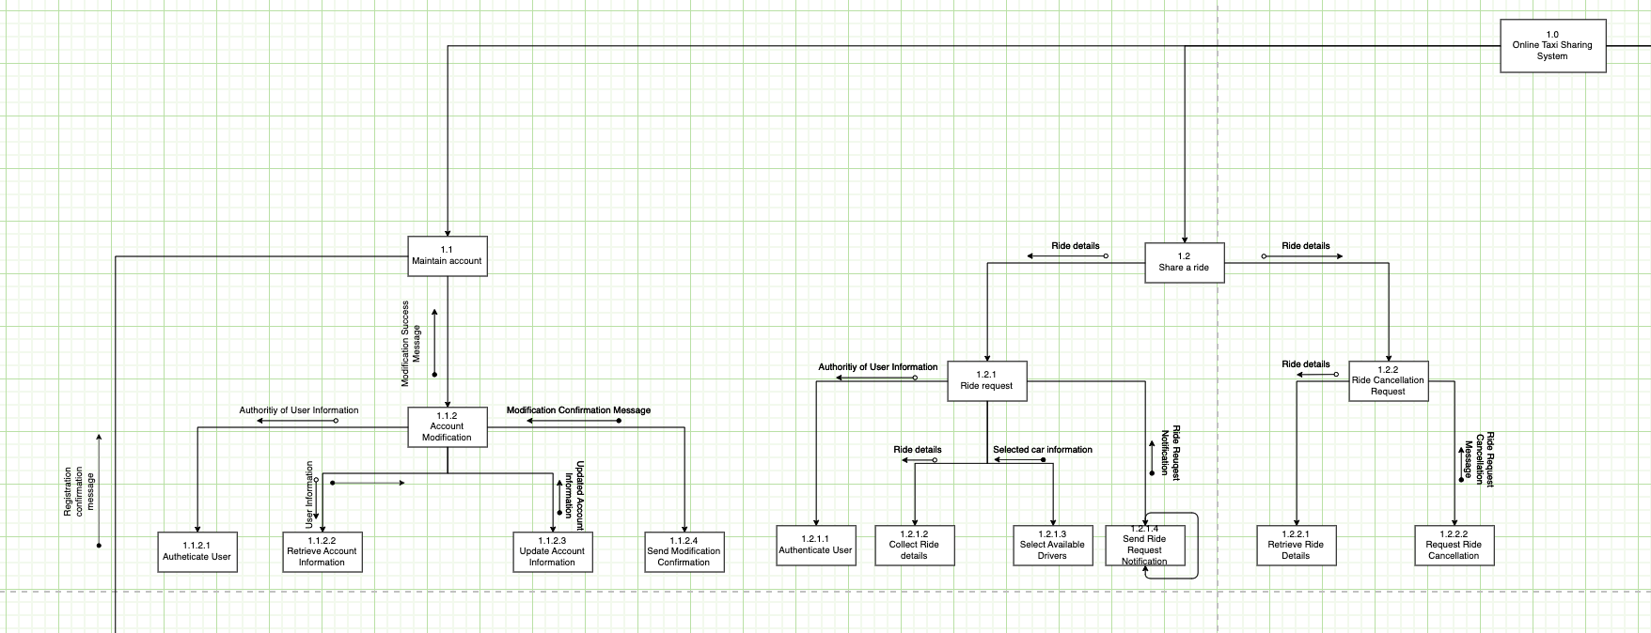
Program Design – Structured Chart
ADA UNIVERSITY
SYSTEM ANALYSIS & DESIGN

Slide 13
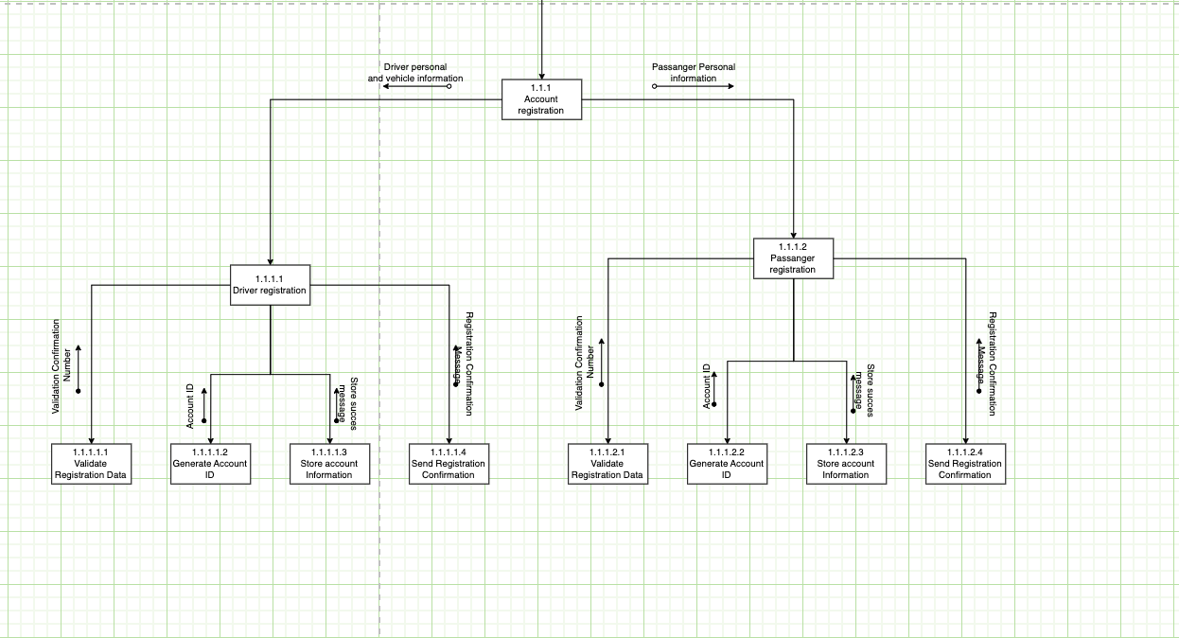
Program Design
ADA UNIVERSITY
SYSTEM ANALYSIS & DESIGN

Slide 14
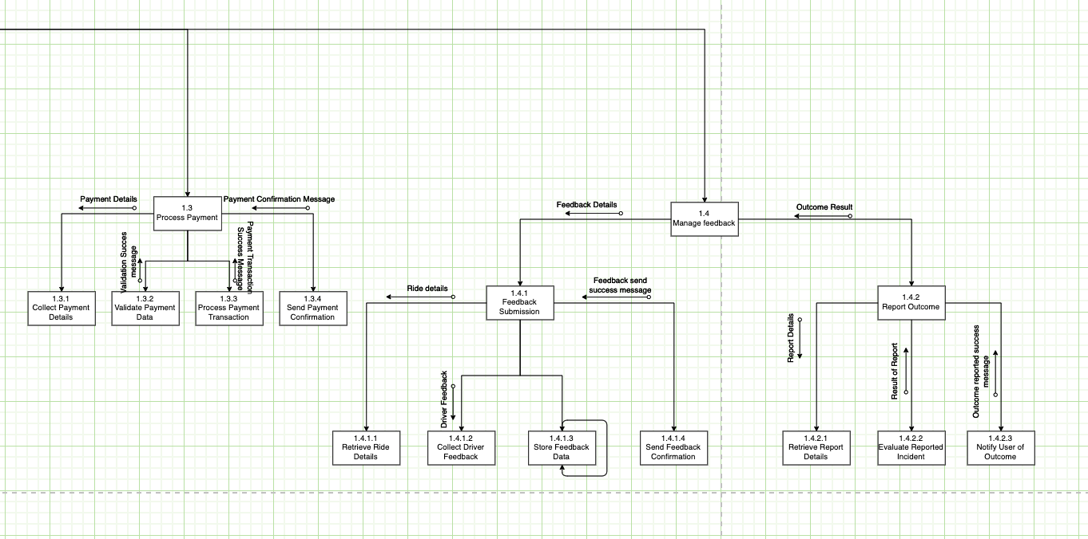
Program Design
ADA UNIVERSITY
SYSTEM ANALYSIS & DESIGN

Slide 15
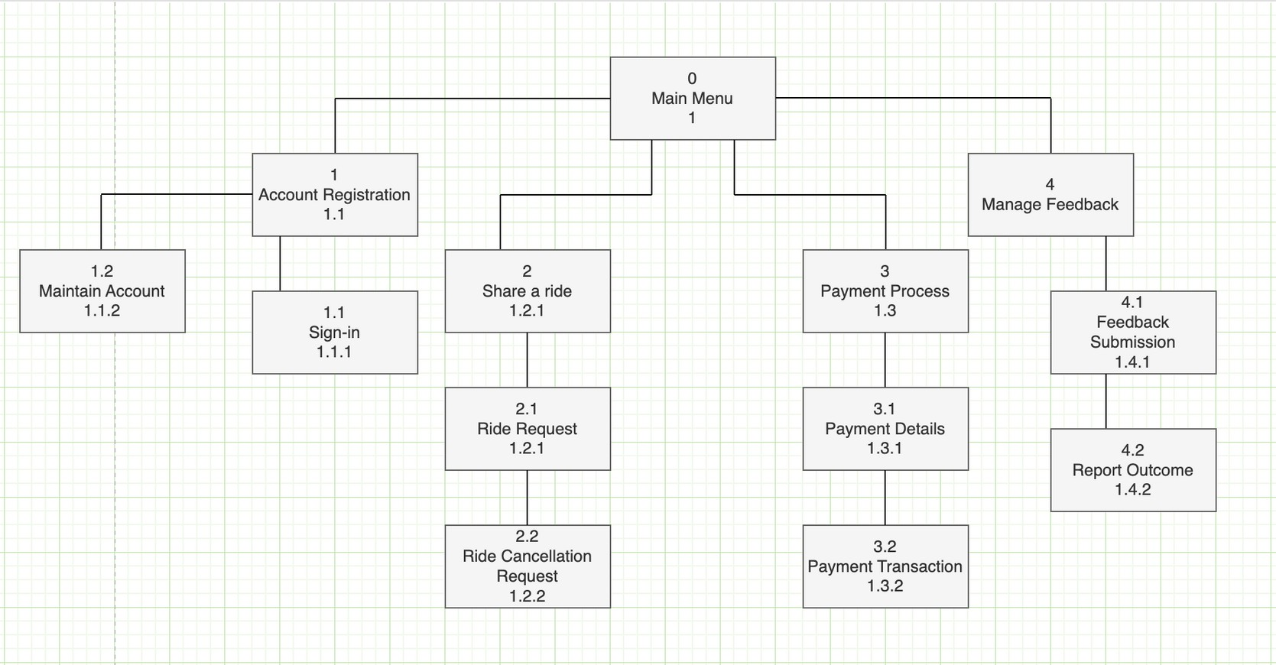
User Interface Design
ADA UNIVERSITY
SYSTEM ANALYSIS & DESIGN

Slide 16
References
ADA UNIVERSITY
SYSTEM ANALYSIS & DESIGN
Dennis, A., Wixom, B. H., & Roth, R. M. (2012). System analysis and design. Hoboken, NJ:
John Wiley
"Uber Clone: How to Build a Taxi App Like Uber" by Cleveroad: https://www.cleveroad.com/blog/uber-clone-how-to-build-a-taxi-app-like-uber "Designing a Ride Sharing App: UX Challenges and Tips" by Tubik Studio: https://tubikstudio.com/designing-a-ride-sharing-app-ux-challenges-and-tips/ "How to Develop a Ride-Sharing App Like Uber or Lyft" by DevTeam.Space:
https://www.devteam.space/blog/how-to-develop-a-ride-sharing-app-like-uber-or-lyft/
"Ride-hailing, ride-sharing, and the future of transportation" by McKinsey & Company: https://www.mckinsey.com/industries/automotive-and-assembly/our-insights/ride- hailing-ride-sharing-and-the-future-of-transportation https://www.carrentalgateway.com/glossary/return-of-investment/ https://www.investopedia.com/terms/b/breakevenpoint.asp https://www.csd.uoc.gr/~hy351/2005/downloads/assisting_lectures/HY351_F2.pdf

Slide 17


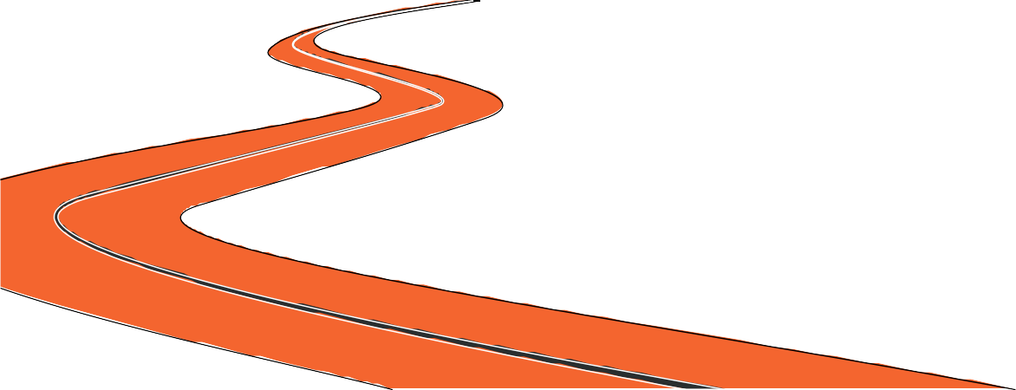
ADA UNIVERSITY
SYSTEM ANALYSIS & DESIGN
Thank you for attention!
PRESENTED BY
TEAM 01
ANAR BAYRAMOV NARGIZ BAYRAMOVA NIGAR SALAYEVA SANAN MARDANLI

